Slide 1
Analysis of Factors that Affected Avocado Prices from 2015-2020
BACKGROUND/MOTIVATION:
As the world is ever-changing, it is clear that the American diet is as well. More and more people are transitioning to a healthier lifestyle and incorporating more whole foods into their diet. Furthermore, there has also been a rise of eating locally grown and organic foods versus the standard option due to both chemical and ethical reasons. For this study, I have chose to focus on Avocados, a whole food that has the option of being organic or conventional and has recently spiked in popularity. As a fellow avocado enthusiast, I have chosen to analyze avocados and how their average prices change overtime.
My research questions I intend to answer are:
In the United States, how does the type of avocado and the region in which it is located impact the average price at which it is sold from the years 2015-2020?
Has the popularity of avocados cause a shift in the amount of organic and conventional avocados sold?
And if so, how does this shift compare with their average prices?
Watson, Kaitlyn

Slide 2

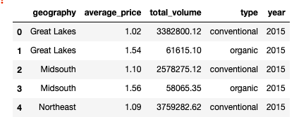
Analysis of Factors that Affected Avocado Prices from 2015-2020
Methodology:
I solely used a data set from Hass Avocado Board that reflected avocado information from the United States
Part 1: Analyzing Average Prices (2015-2020)
Breakdown by region and type using a violin plot
Further breakdown by region and type for each year
Part 2: Analyzing Total Volume Sold By Type of Avocado
Create new dataframes based on each type
Use pie chart to reflect total volume for all years
Breakdown of each year using additional pie charts
Watson, Kaitlyn

Slide 3
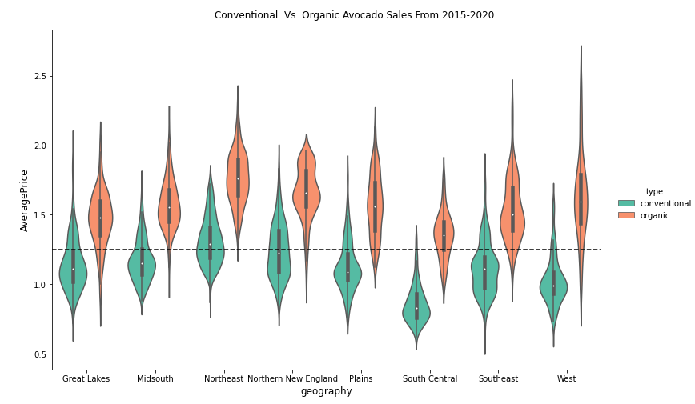
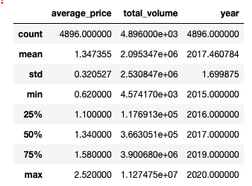
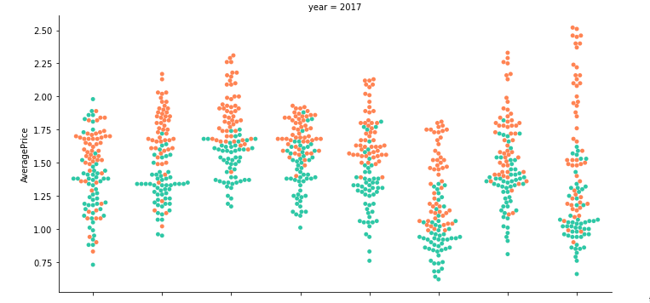
Results: Region vs. Price
West has some of the highest prices for Organic Avocados and Lowest Prices for Conventional Avocados
Majority of organic avocados are above the $1.34 average.
South Central has overall lowest prices for avocados (regardless of type)
Watson, Kaitlyn

Slide 4
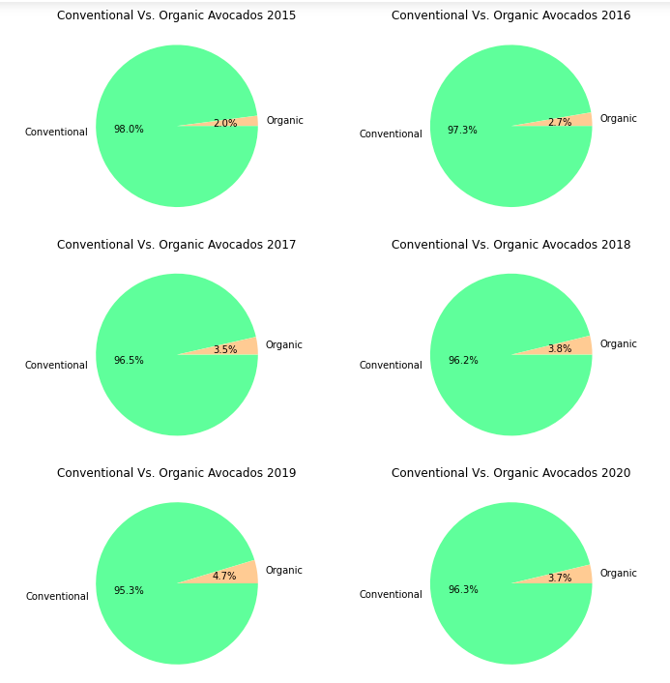
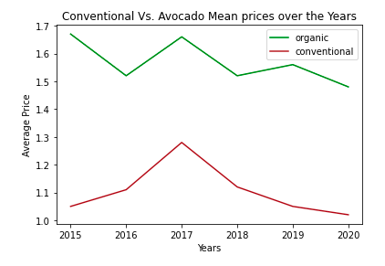
Results: Type vs. Total Volume Sold
From 2015-2019 the volume of organic avocados has slightly increased between 0.3% and 0.9% and then drops by 1% in 2020.
There is direct relation between types of avocados (as organic price increases so does conventional.
Watson, Kaitlyn

Slide 5
Conclusion
What’s so interesting about Avocado Sales?
California is the top grower of avocados (both conventional and organic). Although it makes sense that they would therefore have the lowest conventional prices, it is intriguing as to why the organic prices are the highest of all other regions.
People’s behavior changed when conventional avocados were priced at a $1. They saw $1 as being much cheaper then $1.50 in 2020 which was the price of Organic. Whereas in 2019 and before they increased their purchase of organic even with higher organic and conventional prices.
Was my research questions answered?
Yes! Organic Avocados were almost always more expensive and the region in which an avocado is located heavily depends on the price. Furthermore, as the health trened rose from 2015-2016 there was a slight increase in organic avocado sales, but the pandemic caused people to decrease this purchase in 2020.
Watson, Kaitlyn

